Slide 1

PowerShell for Azure DevOps: Streamlining CI/CD Pipelines
Enhancing DevOps efficiency with automation tools
Notes:
AI-generated content may be incorrect. --- This presentation focuses on how PowerShell can enhance the efficiency of CI/CD pipelines within Azure DevOps. We will explore the fundamentals of Azure DevOps, the role of PowerShell, and best practices for automating DevOps processes.

Slide 2

Agenda for Today's Presentation
Introduction
What Is PowerShell?
Azure DevOps Overview
PowerShell Cmdlets for Azure DevOps
Setting Up Your Environment
Technical Demo Overview
Best Practices
Notes:
We will begin with an introduction to Azure DevOps and the significance of CI/CD in modern software development. We will then discuss PowerShell, its benefits in DevOps, and its relevant modules. Following this, we will explore the key components of Azure DevOps and dive into the specific PowerShell cmdlets used for managing Azure DevOps resources. We'll also cover setting up the environment and provide a technical demo.

Slide 3
Introduction
Notes:
Understanding the foundational concepts of Azure DevOps is crucial. This section will highlight a brief overview of Azure DevOps, its significance in the modern software development landscape, and how PowerShell plays a pivotal role in automating various DevOps processes.

Slide 4

Brief Overview of Azure DevOps
Comprehensive Tool Suite
Azure DevOps provides a complete set of development tools, enhancing collaboration and productivity throughout the software development lifecycle.
Source Control Features
The platform includes robust source control features, allowing teams to manage code changes efficiently and maintain version history.
Project Management Integration
Azure DevOps integrates project management capabilities, supporting planning, tracking, and managing software projects seamlessly.
CI/CD Pipelines
The CI/CD pipelines in Azure DevOps automate the software delivery process, ensuring rapid and reliable deployment of applications.
Notes:
Azure DevOps is a comprehensive suite of development tools and services that facilitate collaboration and productivity in software development. It offers features like source control, project management, and CI/CD pipelines, all in one integrated platform.

Slide 5

Importance of CI/CD in Modern Software Development
Enhancing Collaboration
CI/CD practices foster team collaboration by integrating code changes frequently, allowing for immediate feedback and improved communication.
Reducing Integration Issues
By regularly integrating code, CI/CD minimizes integration issues, leading to a more stable codebase and smoother release cycles.
Faster Delivery of Features
CI/CD enables teams to deliver features and bug fixes to users more rapidly, enhancing overall productivity and user satisfaction.
Notes:
Continuous Integration and Continuous Deployment (CI/CD) practices are vital for delivering software efficiently. CI/CD enhances collaboration, reduces integration issues, and enables faster delivery of features and bug fixes.

Slide 6

Role of PowerShell in Automating DevOps Processes
Task Automation
PowerShell enables DevOps professionals to automate repetitive tasks, saving time and minimizing human error in processes.
Resource Management
With PowerShell, managing resources becomes more efficient, allowing teams to allocate and track resources effectively.
Streamlining Workflows
PowerShell streamlines complex workflows, integrating various tools and processes seamlessly within the DevOps environment.
CI/CD Efficiency
PowerShell significantly improves Continuous Integration and Continuous Deployment processes, accelerating software delivery cycles.
Notes:
PowerShell is a powerful scripting language that allows DevOps professionals to automate tasks, manage resources, and streamline workflows. It simplifies complex operations and improves the efficiency of CI/CD processes.

Slide 7
What Is PowerShell?
Notes:
PowerShell is a task automation framework that consists of a command-line shell and an associated scripting language. This section will provide a quick introduction to PowerShell, its benefits in a DevOps context, and relevant modules for Azure DevOps.

Slide 8

Quick Introduction to PowerShell
Powerful Toolset
PowerShell is a comprehensive toolset designed specifically for system administrators and developers, enhancing productivity.
Automation Capabilities
With PowerShell, users can automate routine system management tasks, saving time and reducing errors.
Scripts and Cmdlets
PowerShell utilizes scripts and cmdlets to execute commands, allowing for seamless management of systems and applications.
Notes:
PowerShell provides a powerful toolset for system administrators and developers, allowing them to automate the management of systems and applications through scripts and cmdlets.

Slide 9

Benefits of Using PowerShell in DevOps
Improved Automation Capabilities
PowerShell enhances automation in DevOps, allowing teams to streamline repetitive tasks and processes efficiently.
Consistency in Deployment
By using PowerShell, teams can ensure consistent deployment processes across different environments, reducing errors and improving reliability.
Seamless Integration
PowerShell's ability to integrate with various systems and tools allows for a cohesive DevOps workflow, enhancing productivity.
Notes:
Using PowerShell in DevOps provides several benefits, including improved automation capabilities, consistency in deployment processes, and the ability to integrate with various systems and tools seamlessly.

Slide 10

Overview of PowerShell Modules Relevant to Azure DevOps
PowerShell Modules for DevOps
Specific PowerShell modules are tailored for Azure DevOps to facilitate project and resource management.
Cmdlets for Automation
These modules offer cmdlets that automate tasks related to management of pipelines and projects in Azure DevOps.
Efficient DevOps Management
Using PowerShell modules enhances the efficiency of DevOps practices through streamlined processes and automation.
Notes:
There are specific PowerShell modules designed for Azure DevOps that provide cmdlets for managing projects, pipelines, and other resources, allowing for efficient automation of DevOps tasks.

Slide 11
Azure DevOps Overview
Notes:
This section will provide an overview of Azure DevOps and its key components, illustrating how CI/CD fits into the overall Azure DevOps ecosystem and enhancing the development lifecycle.

Slide 12
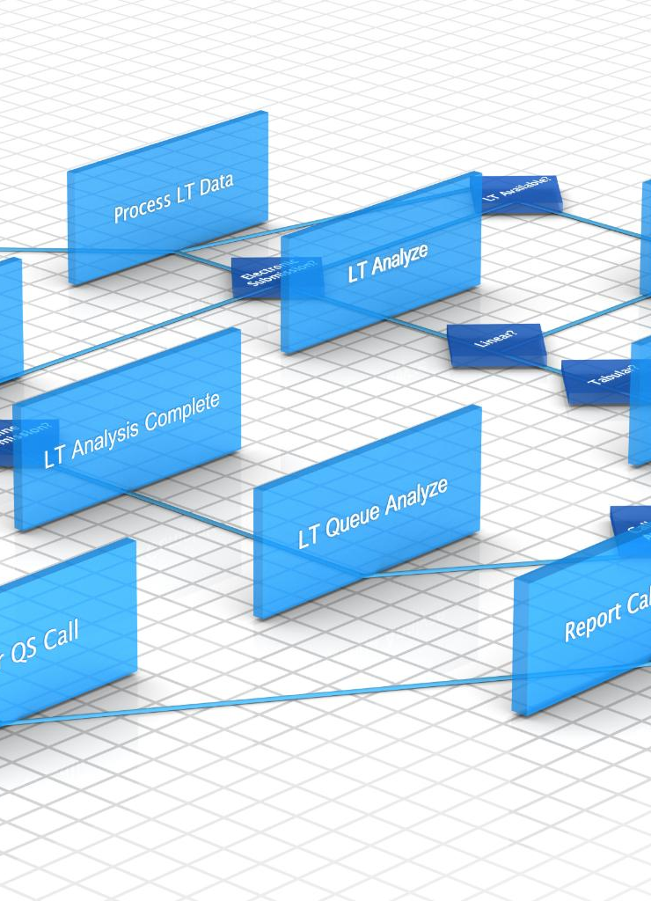
Key Components of Azure DevOps (Repos, Pipelines, Boards, Etc.)
Version Control with Repos
Azure Repos provides version control capabilities, allowing teams to manage code changes effectively and collaborate seamlessly.
CI/CD Automation with Pipelines
Pipelines automate the continuous integration and continuous delivery processes, enhancing deployment speed and reliability.
Work Tracking with Boards
Azure Boards helps teams track work items, manage backlogs, and visualize progress, ensuring project transparency and efficiency.
Notes:
Azure DevOps consists of several key components, including Repos for version control, Pipelines for CI/CD automation, and Boards for tracking work. Each component plays a crucial role in the development process.

Slide 13

How CI/CD Fits Into the Azure DevOps Ecosystem
Continuous Integration
Continuous integration allows teams to integrate code changes frequently, enhancing collaboration and reducing integration issues.
Continuous Deployment
Continuous deployment automates the release of software updates, ensuring that changes are delivered to users rapidly and reliably.
Streamlined Workflows
CI/CD streamlines workflows, allowing teams to focus on delivering value rather than managing manual deployment processes.
Notes:
CI/CD is a central part of Azure DevOps, allowing teams to integrate and deploy code changes continuously. This integration streamlines development workflows and enhances collaboration among team members.

Slide 14
PowerShell Cmdlets for Azure DevOps
Notes:
In this section, we will delve into the specific PowerShell cmdlets that are crucial for managing Azure DevOps resources efficiently, relevant to both project management and automation tasks.

Slide 15
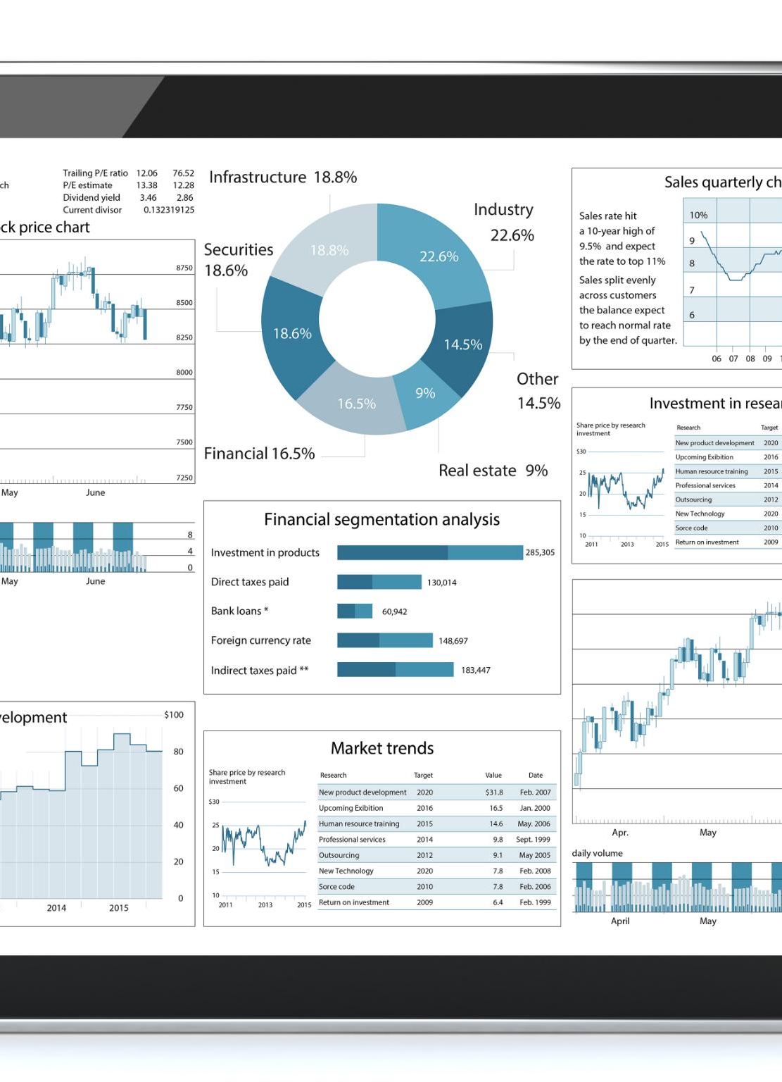
Introduction to Azure DevOps PowerShell Module
Interaction with Azure DevOps
The Azure DevOps PowerShell module enables seamless interaction with Azure DevOps Services through various cmdlets.
Simplified Resource Management
This module simplifies the management of Azure DevOps resources, making it easier for users to handle tasks efficiently.
Automation of Tasks
Using PowerShell cmdlets, users can automate various tasks in Azure DevOps, enhancing productivity and workflow.
Notes:
The Azure DevOps PowerShell module provides a set of cmdlets that allow users to interact with Azure DevOps Services. This module simplifies the management of Azure DevOps resources and tasks.

Slide 16

Key Cmdlets for Managing Azure DevOps Resources (E.g., Get-AzDevOpsProject, New-AzDevOpsPipeline, Etc.)
Get-AzDevOpsProject
Get-AzDevOpsProject cmdlet is used to list and manage Azure DevOps projects efficiently.
New-AzDevOpsPipeline
New-AzDevOpsPipeline cmdlet is essential for creating new CI/CD pipelines in Azure DevOps.
Importance of Cmdlet Mastery
Mastering these cmdlets is crucial for effective automation and management of Azure DevOps resources.
Notes:
Important cmdlets for managing Azure DevOps resources include Get-AzDevOpsProject for listing projects and New-AzDevOpsPipeline for creating new CI/CD pipelines. Mastering these cmdlets is essential for effective automation.

Slide 17
Setting Up Your Environment
Notes:
Before using PowerShell with Azure DevOps, it's essential to set up your environment correctly. This section covers prerequisites, installation of the Azure DevOps PowerShell module, and authentication processes.

Slide 18

Prerequisites for Using PowerShell with Azure DevOps
Azure DevOps Account
Users must possess a valid Azure DevOps account to access and utilize its services effectively.
Required Permissions
Having the correct permissions is crucial for executing PowerShell commands within Azure DevOps environments.
PowerShell Modules
The appropriate PowerShell modules need to be installed to interact seamlessly with Azure DevOps services.
Notes:
To use PowerShell with Azure DevOps, users must have the necessary permissions and prerequisites in place, including a valid Azure DevOps account and the appropriate modules installed.

Slide 19

Installing the Azure DevOps PowerShell Module
Simple Installation Process
The installation of the Azure DevOps PowerShell module involves executing specific PowerShell commands, making it easy for users.
Leverage Azure DevOps
By installing the module, users can leverage Azure DevOps capabilities directly within their PowerShell scripts, enhancing automation.
Notes:
Installing the Azure DevOps PowerShell module is a straightforward process that can be accomplished via PowerShell commands. This allows users to leverage Azure DevOps functionality through PowerShell scripts.

Slide 20
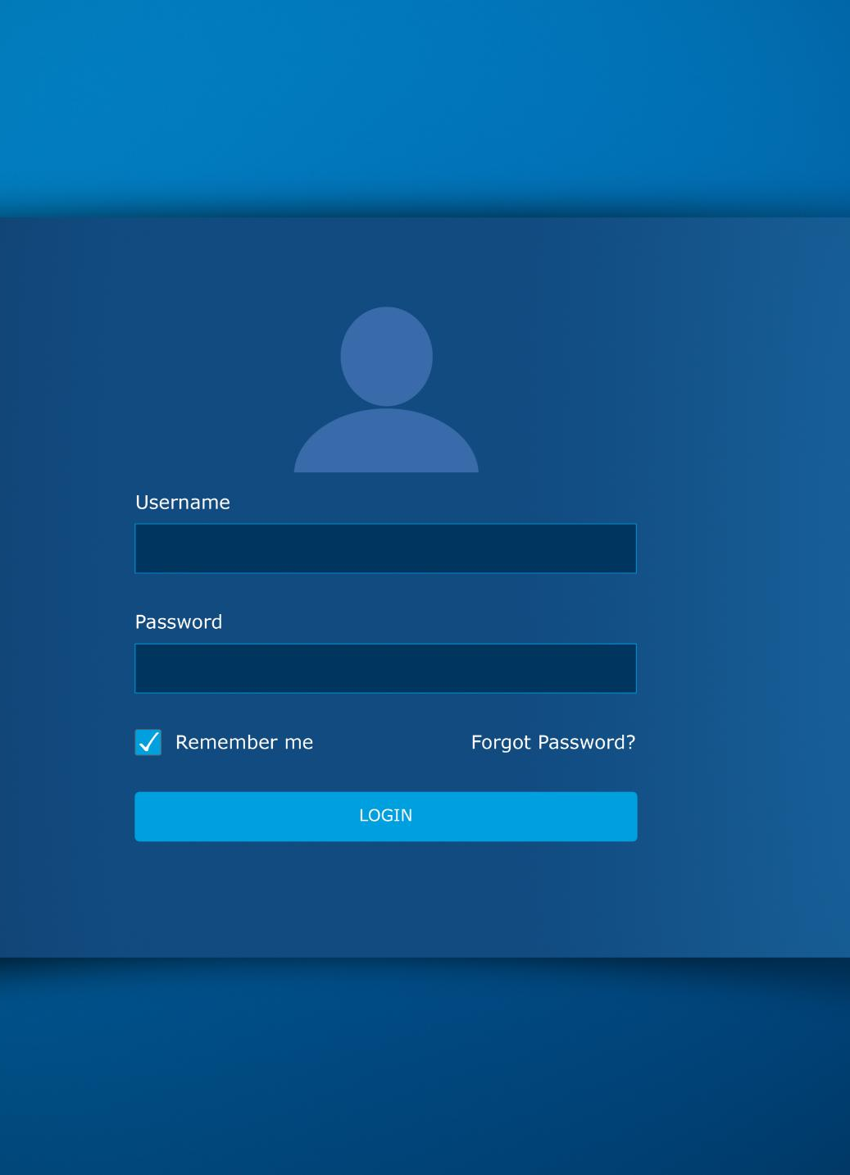
Authenticating to Azure DevOps Using PowerShell
Importance of Authentication
Authentication is essential for securely interacting with Azure DevOps services using PowerShell commands.
Personal Access Tokens
Users can authenticate with Azure DevOps using personal access tokens, providing a secure way to access services.
Azure Active Directory
Azure Active Directory credentials offer an alternative authentication method, integrating with existing security frameworks.
Notes:
Authentication is critical for interacting with Azure DevOps services using PowerShell. Users can authenticate using personal access tokens or Azure Active Directory credentials, ensuring secure access to resources.

Slide 21
Technical Demo Overview
Notes:
In this section, we will provide a brief outline of the technical demonstration, showcasing a practical example of automating the creation of a CI/CD pipeline using PowerShell.

Slide 22
Briefly Outline What You Will Demonstrate
CI/CD Pipeline Automation
This demo will showcase the automation of a Continuous Integration and Continuous Deployment pipeline, streamlining the software development process.
Step-by-Step Process
The demonstration will provide a clear, step-by-step guide on setting up the CI/CD pipeline using PowerShell in Azure DevOps.
Azure DevOps Integration
Learn how to effectively utilize Azure DevOps for automating deployments and managing the software development lifecycle.
Notes:
The demo will illustrate the step-by-step process of automating a CI/CD pipeline creation in Azure DevOps using PowerShell. This practical example will help solidify the concepts discussed.

Slide 23

Example Scenario: Automating the Creation of a CI/CD Pipeline Using PowerShell
Real-World Scenario
We'll explore a practical example where PowerShell automates the setup of a CI/CD pipeline, showcasing its applicability in real projects.
PowerShell Efficiency
PowerShell scripts enhance the efficiency of the DevOps process, simplifying the automation of complex tasks in the pipeline.
DevOps Integration
Integrating PowerShell into the CI/CD pipeline streamlines workflows and fosters collaboration between development and operations teams.
Notes:
We will walk through a real-world scenario where PowerShell scripts are used to automate the setup of a CI/CD pipeline. This will demonstrate the ease and efficiency that PowerShell brings to the DevOps process.

Slide 24
Best Practices
Notes:
This section will cover best practices for using PowerShell in Azure DevOps, including tips for effective scripting, error handling, and version control to ensure reliable and maintainable automation.

Slide 25

Tips for Using PowerShell in Azure DevOps
Writing Clear Scripts
Ensure your scripts are clear and maintainable for better collaboration and future updates.
Using Comments Effectively
Incorporate comments in your scripts to explain functionality and enhance readability for others.
Leveraging Built-in Help
Utilize PowerShell's built-in help features to quickly access information about cmdlets and functions.
Notes:
Effective use of PowerShell in Azure DevOps involves following best practices, such as writing clear and maintainable scripts, using comments effectively, and leveraging built-in help features.

Slide 26

Error Handling and Logging
Importance of Error Handling
Effective error handling is essential for identifying and managing issues in PowerShell scripts, ensuring reliability and stability.
Using Try/Catch Blocks
Incorporating try/catch blocks allows for graceful error handling and prevents script crashes, enhancing user experience.
Logging for Troubleshooting
Logging output is vital for troubleshooting errors, providing insights and context when issues arise in scripts.
Notes:
Implementing proper error handling and logging in PowerShell scripts is crucial for identifying issues and maintaining script reliability. This includes using try/catch blocks and logging output for troubleshooting.

Slide 27

Version Control for PowerShell Scripts
Importance of Version Control
Version control is crucial for managing PowerShell scripts, ensuring changes are tracked and organized.
Collaboration in Teams
Using version control systems like Git enhances collaboration, allowing multiple developers to work on scripts simultaneously.
Reverting Changes
Version control systems enable teams to revert to previous versions of scripts when necessary, ensuring stability.
Notes:
Version control is essential for managing PowerShell scripts. Using Git or other version control systems allows teams to track changes, collaborate effectively, and revert to previous versions when necessary.

Slide 28
Conclusion
PowerShell Automation Benefits
PowerShell enhances automation capabilities, leading to more efficient workflows and reduced manual intervention.
Streamlined CI/CD Pipelines
Integrating PowerShell into CI/CD pipelines streamlines software delivery processes, improving overall project efficiency.
Focus on Quality Software
Automation allows teams to focus on delivering high-quality software, minimizing errors and enhancing user satisfaction.
Notes:
In conclusion, PowerShell significantly enhances the automation capabilities within Azure DevOps, streamlining CI/CD pipelines and improving overall efficiency. By leveraging PowerShell, teams can automate complex processes and focus on delivering high-quality software.

